Slide 1
DIGITAL COMMUNICATION
ETEC-303
LECTURE-I
14th Sept’21

Slide 2
Course Description:
It has 4 units which broadly covers
Unit 1
Introduction (Basics of Digital Comm.)
Line coding techniques
Sampling Theorem
Pulse Digital Modulation Techniques
Unit 2
Random Signal Theory (which includes both Random Signal and Random Process)
Unit 3
Designing of Receivers
Types of Filters
Unit 4
Digital Modulation
Techniques

Slide 3
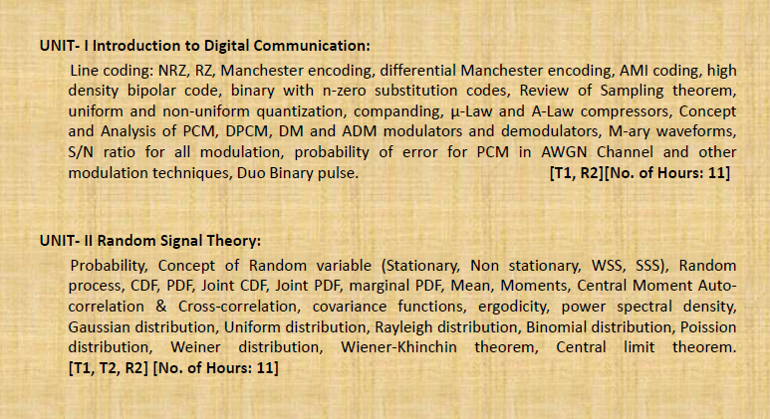
Syllabus Overview

Slide 4
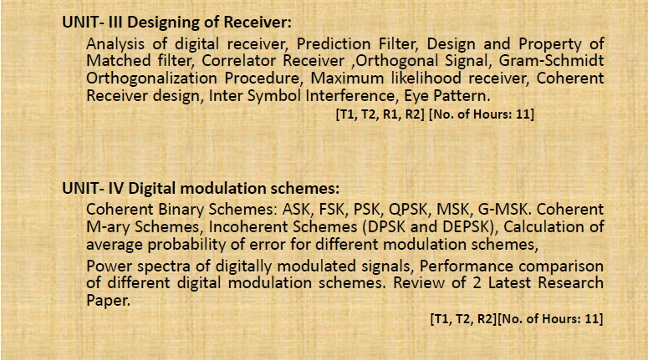
Syllabus Overview

Slide 5
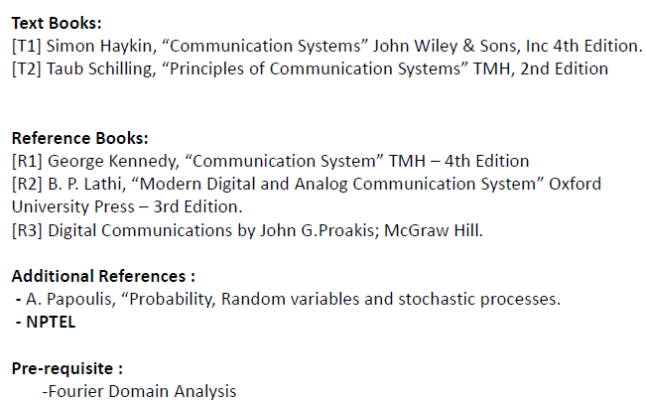
Reference Books

Slide 6
Minimum Bare Pre-requisites:
Kindly keep your video and audio off until told to do on.
If you have any queries during the lecture, put it on the chat window and raise your hand. All the queries would be handled during the last 10 minutes of every lecture.

Slide 7
Points you all should know:
Attendance Check: Ms Teams has a feature in which your attendance will be automatically marked. Remember: In it, your every in and out entry is visible in the attendance sheet.
Performance Check: In the last 10 minutes of query/doubt session, I will also ask any of you the questions related to the lecture. So, your performance would be noted on daily basis. i.e along with your online (physical) Attendance, your (mental) Attendance also counts.
Lecture Summary: is provided to you at the end of every lecture. Kindly note it down.
The book includes many topics in a particular chapter. So lecture summary will enable you to
know what to be read and what not to be read and how deeply you should go in every topic.
So do try to be present in every lecture. And make the lecture summary notes.

Slide 8
Myths:
This subject is tough.
This subject is not at all tough, rather it is very conceptual. It will be assured that if you attend classes properly, you will be able to answer every concept by the end of lecture itself.
2. This is not core CS subject so why to study it.
It is equally beneficial to understand the hardware of circuit along with the software. It is just like knowing the ‘theory' before ‘practical'.
It is not your core subject but it is one of the five or six subjects of this semester.
This subject is very scoring as it includes numericals as well as concepts.
3. This course is quite voluminous.
Digital comm. has less course than analog communication.
The course always gets complete within the allotted classes of the session. ☺

Slide 9
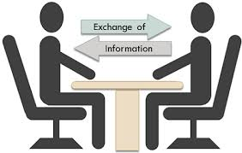
COMMUNICATION
Communication can be defined as the process of exchange of information through means such as words, actions, signs, etc., between two or more individuals.

Slide 10
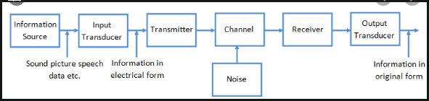
Parts of a Communication System:
Any system, which provides communication consists of the three important and basic parts as shown in the following figure.
Sender is the person who sends a message. It could be a transmitting station from where the signal is transmitted. (SENDING)
Channel is the medium through which the message signals travel to reach the destination. (PROCESSING)
Receiver is the person who receives the message. It could be a receiving station where the transmitted signal is being received. (RECEIVING)

Slide 11
Signals…
The signals we use in the real world are called "analog" signals. (eg: Speech, weather signals).
The communication that occurs in our day-to-day life is in the form of signals. These signals, such as sound signals, generally, are analog in nature.
When the communication needs to be established over a distance, then the analog signals are sent through wire, using different techniques (AM, FM, PM) for effective transmission.

Slide 12
Signals…
The conventional methods of communication used analog signals for long distance communications, which suffer from many losses such as distortion, interference, and other losses including security breach.
In order to overcome these problems, the signals are digitized using different techniques. The digitized signals allow the communication to be clearer and more accurate without losses.

Slide 13
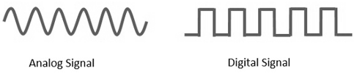
Signals…
Analog signal is continuous in both time and amplitude.
Digital signal is discrete in both time and amplitude.
The digital signals consist of 1’s and 0’s which indicate high and low values respectively.

Slide 14
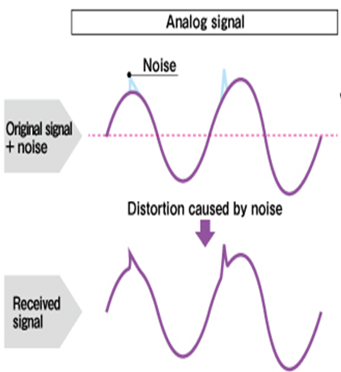
Noise in Analog Signals:
Case 1: Analog signals: They use an infinite number of signal values to represent data.
Any small fluctuations in the signal will mean an alteration or loss of data.

Slide 15
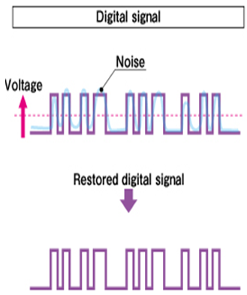
Noise in Digital Signals:
Case 2: Digital signals:
They use 2 different amplitude levels
to represent information (HIGH or LOW).
For e.g. HIGH=5 V and LOW = 0 V.
The difference between the two levels/values is clear.
Receivers usually have some sort of threshold to accommodate any signal fluctuations or disturbances (a noise margin).
For eg. The signal is 5 V and momentarily dips
to 4.3 V (due to noise), the receiver can still
receive HIGH (5V) as it is close enough to
the original HIGH value.

Slide 16
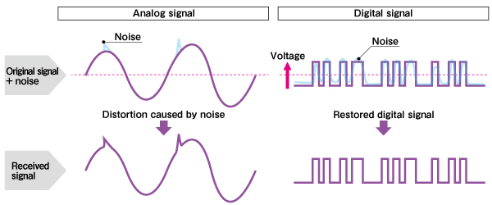
Digital Signal Key Advantage:
Noise Immunity:

Slide 17
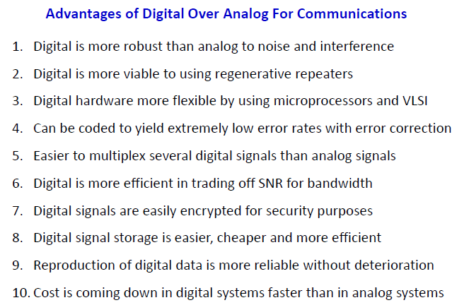
Analog V/S Digital Communication

Slide 18
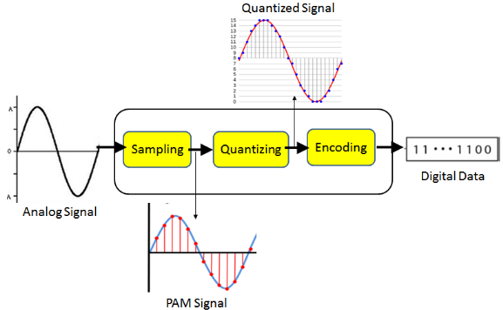
Three steps are involved in A/D conversion:
1. Sampling 2. Quantization 3. Encoding

Slide 19
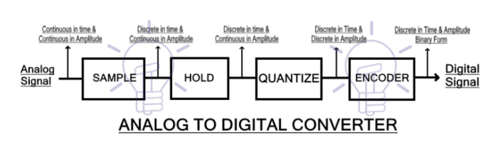
Block Diagram of ADC…

Slide 20
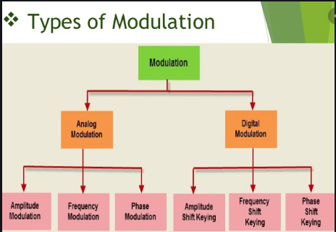
Analog V/S Digital Modulation Types:

Slide 21
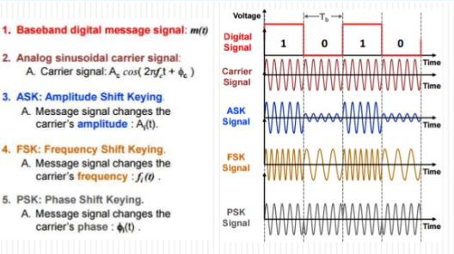
Digital Modulation Types:

Slide 22
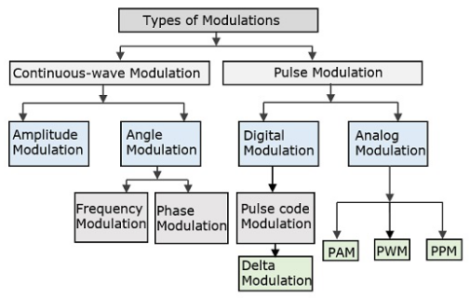
Continuous V/S Pulse Modulation

Slide 23
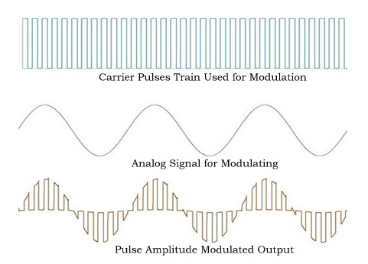
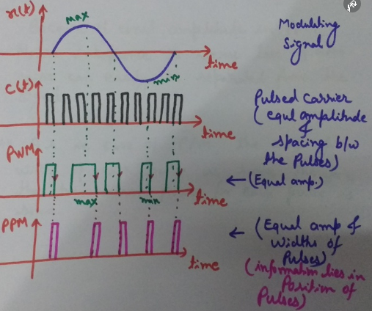
Pulse Amplitude Modulation

Slide 24
Pulse Width & Position Modulation

Slide 25
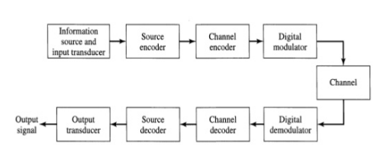
Basic Elements of a Digital Comm. System

Slide 26
Basic Elements:
Information Source
The source can be an analog signal. Example: Audio, Video, Image
Can be a Discrete Data eg. Computer Data
Input Transducer
This is a transducer which takes a physical input and converts it to an electrical signal (Eg: microphone).
A digital signal is generally represented by a binary sequence.
Source Encoder
For Analog: Redundancy Reduction: It removes the redundancy, unnecessary excess bits, using PCM, DPCM, DM, ADM techniques.
For Digital: Data Compression: It compresses the data into minimum no. of bits. (using Shannon Fano and Huffman coding techniques).
Bw. Utilization: This process helps in effective utilization of the bandwidth.

Slide 27
Basic Elements:
Channel Encoder
It provides noise immunity.
The channel encoder, does the coding for error correction. During the transmission of the signal, due to the noise in the channel, the signal may get altered and hence to avoid this, the channel encoder adds some redundant bits to the transmitted data. These are the error correcting bits (using Block Codes, Cyclic Codes, Convolutional Codes).
Digital Modulator
Convert digital electrical signal into high frequency modulated signal by modulating it with a high frequency carrier eg. Coswct.
Through ASK, PSK, PSK techniques.
The signal is also converted to analog from the digital sequence, in order to make it travel through the channel or medium.
Channel/Medium
It allows the analog signal to transmit from transmitter to receiver end.

Slide 28
Basic Elements:
Digital Demodulator
This is the first step at the receiver end. The received signal is demodulated as well as converted again from analog to digital. The signal gets reconstructed here.
Channel Decoder
The channel decoder, after detecting the sequence, does some error corrections. The distortions which might occur during the transmission, are corrected by adding some redundant bits. This addition of bits helps in the complete recovery of the original signal.
Source Decoder
The resultant signal is once again digitized by sampling and quantizing so that the pure digital output is obtained without the loss of information. The source decoder recreates the source output.

Slide 29
Basic Elements:
Output Transducer
This is the last block which converts the signal into the original physical form, which was at the input of the transmitter. It converts the electrical signal into physical output (Example: loud speaker).
Output Signal
This is the output which is produced after the whole process. Example − The sound signal received.

Slide 30
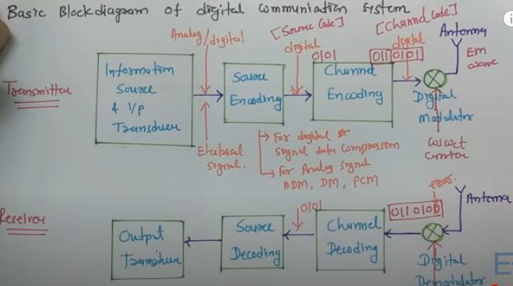
DIGITAL COMM. SYSTEM

Slide 31
Lecture-I Summary
Basic Communication Process
Difference between Analog & Digital Signal
Advantages of digital over analog communication
How to convert Analog to Digital Signal?
Explain
Analog Modulation & it's types
b) Pulse Analog Modulation & it's types
c) Pulse Digital Modulation & it's types
Digital Modulation & it's types
6. Block Diagram of Digital Communication System

